Slide 1
Remote DC Motor Monitoring and Controlling System
18M38127 LANG, Chen
18M38185 ZHANG, Zhiyang
18M38110 GAO, Tianyang

Slide 2
Responsibility
LANG, Chen:
Hardware Design, Motor Controller Software
Zhang, Ziyang:
UI Design, Remote Controller Software
Gao, Tianyang:
UI Design, Remote Controller Software

Slide 3
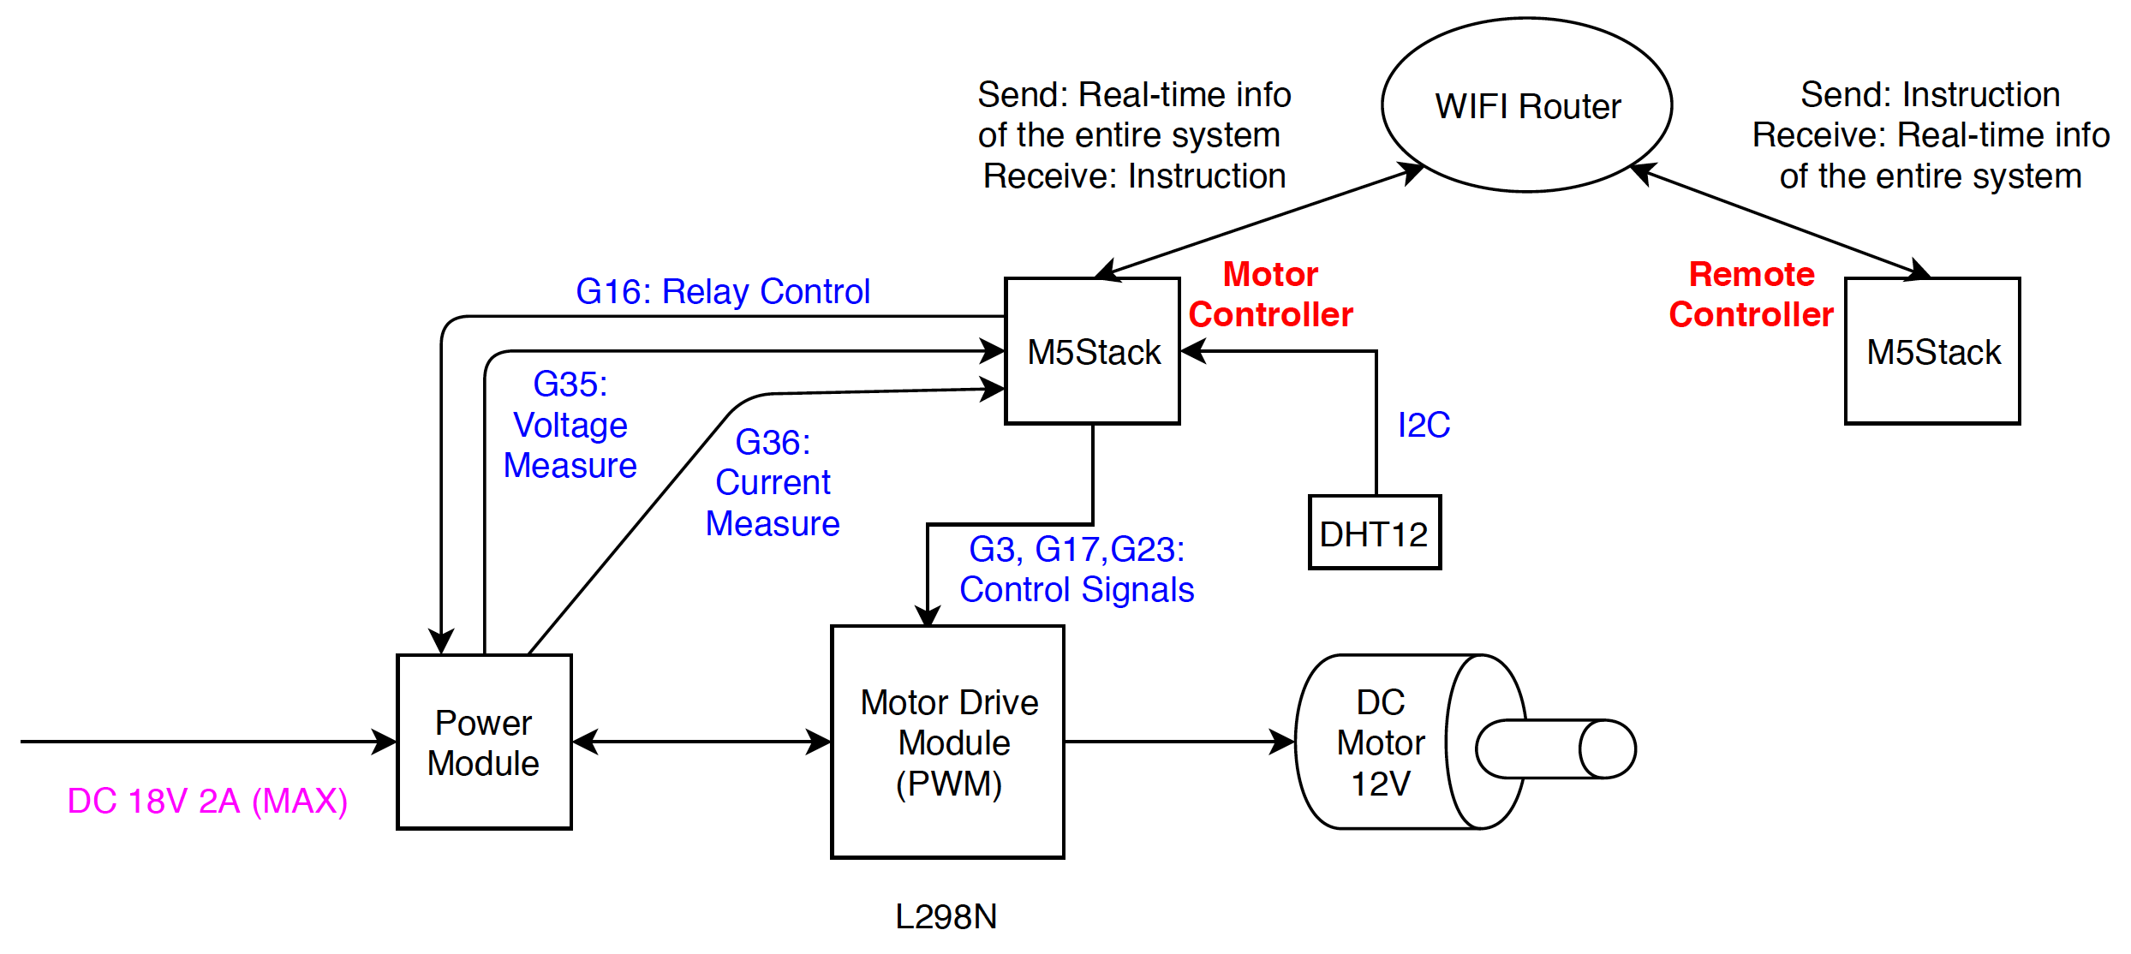
Functionality
Notes:
1. Control the output power and switch the operating direction of a DC motor; 2. Make the DC motor accelerate and decelerate when output power or operating direction is changed; 3. Collect the operating status of the entire system: voltage, current, temperature, motor direction and output power; 4. Prevent the entire system from overcurrent, overvoltage or undervoltage: 8~13V, 2A; 5. Control and monitor the entire system remotely via WIFI.

Slide 4
Design
Hardware - Peripheral Circuits
Software - Motor Controller
Software - Remote Controller

Slide 5
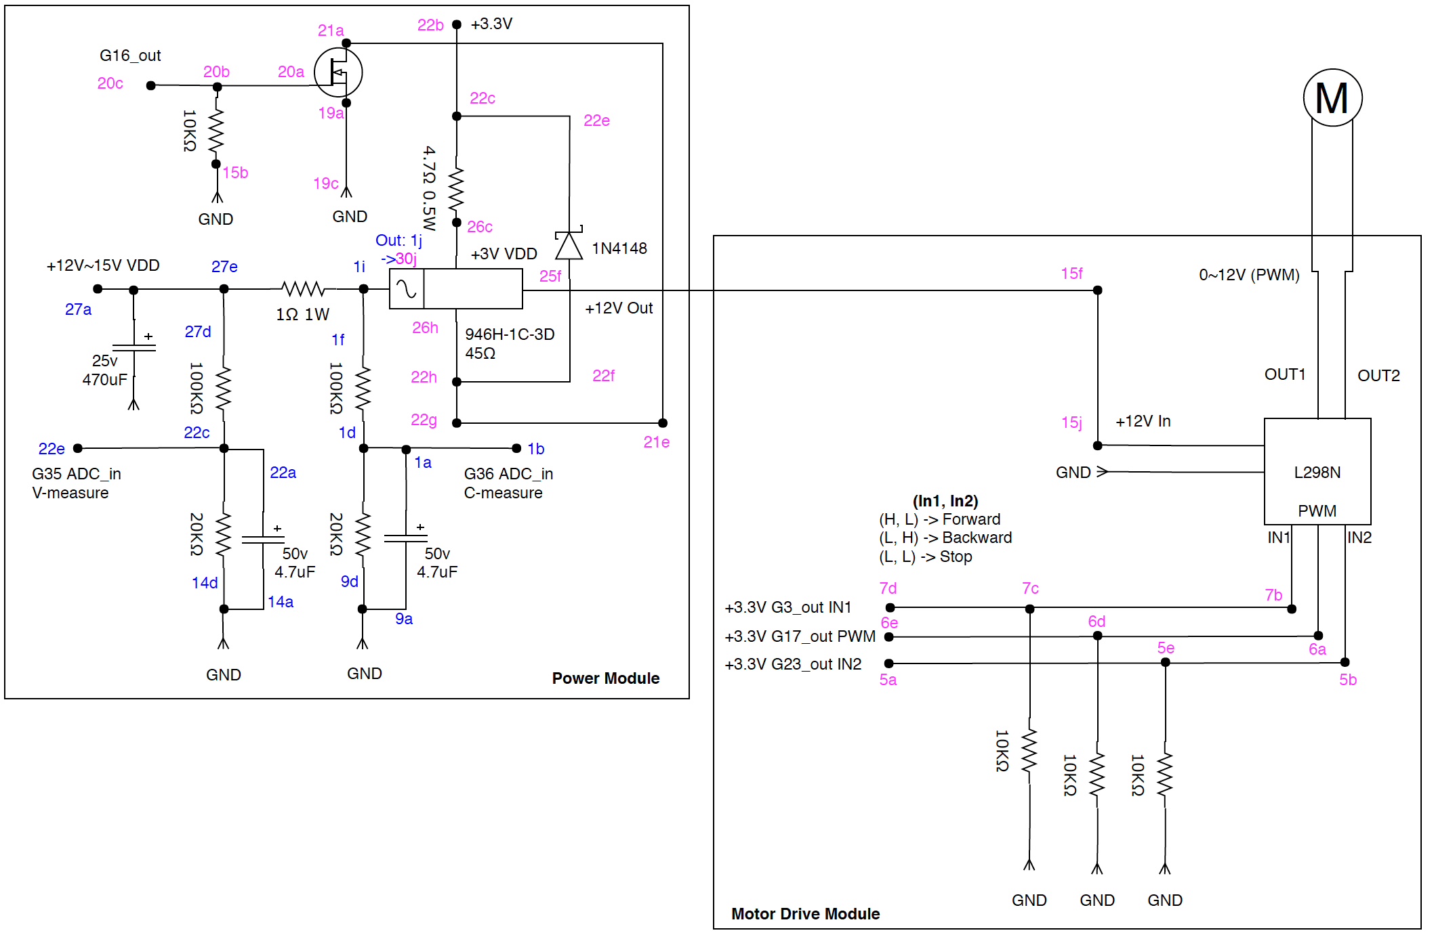
Hardware
Notes:
0. Explain the purposes of pins.
1. Why switching diode? (Protecting purpose, since the relay. Why relay? Because we want to cut off the power once...)

Slide 6
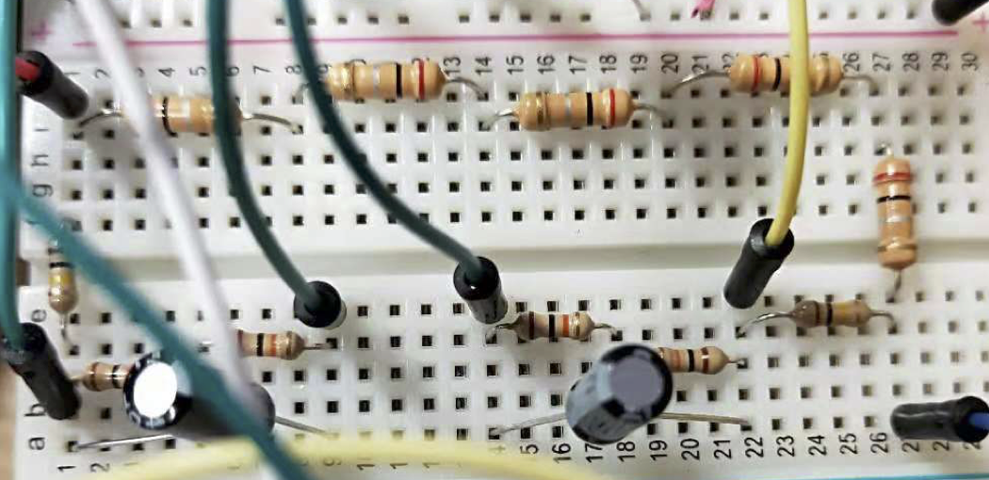
Measure Voltage and Current
Input voltage is higher than 3.3V
ADC only measure voltage -> Use ohm’s law

Slide 7
Why use capacitor?
Output signal from M5Stack GPIO pins are not stable sometimes)

Slide 8
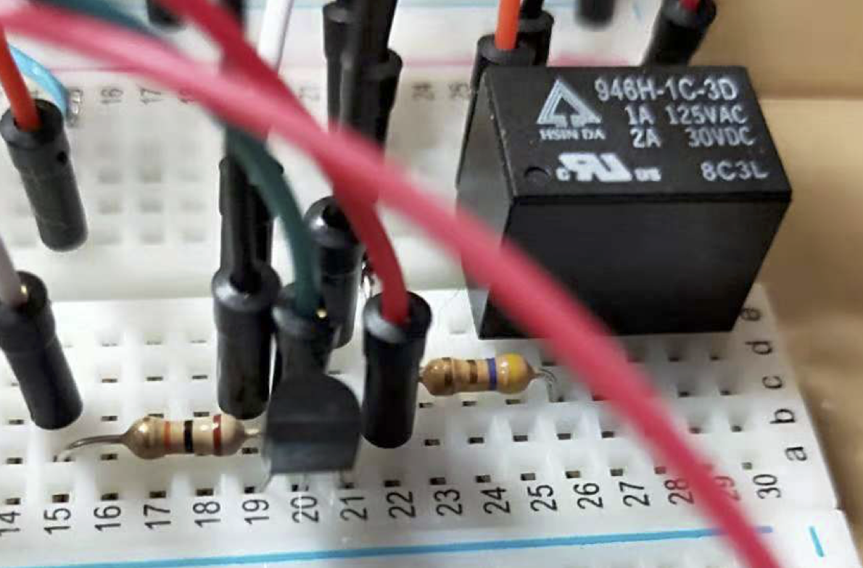
Control The Relay
Output power of the M5Stack GPIO pins is really low. Even though this relay can be driven with really small power.

Slide 9
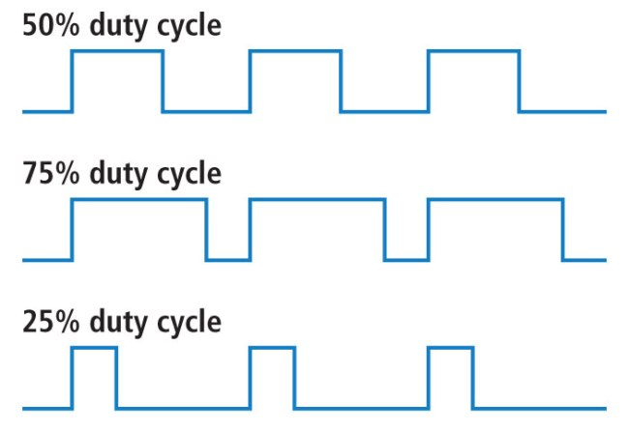
Software - Motor Controller
4 Tasks: Motor Drive, Status Scan, I2C Reader, Network
Priority: 4, 3, 2, 1
Period: 1ms, 50ms, 100ms, 10ms
- PWM Controlling needs output controlling signal with precise time interval. In our system, the frequency of the PWM wave is 100Hz.
Notes:
The left one has the higher priority and shorter period.
Explain a little bit about I2C (transmission requires time) and Network (TCP connection)

Slide 10
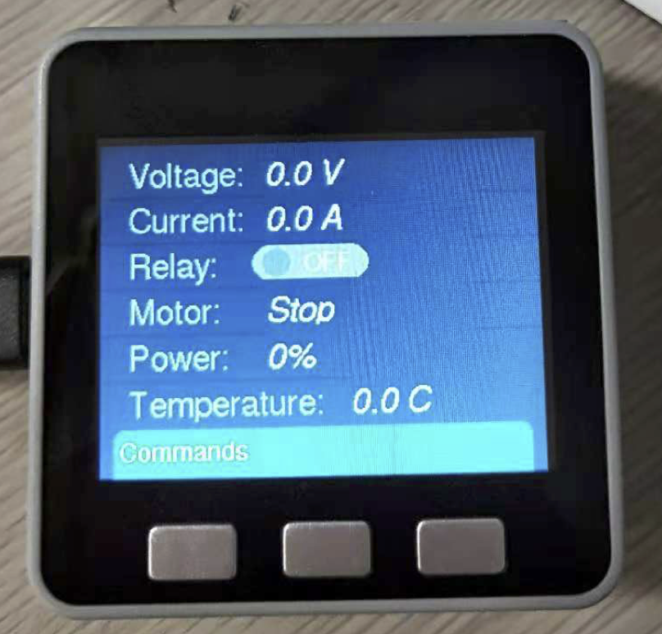
Software - Motor Controller
4 Tasks: Motor Drive, Status Scan, I2C Reader, Network
Priority: 4, 3, 2, 1
Period: 1ms, 50ms, 100ms, 10ms
- Scanning voltage and current is used to protect the entire system, so it must be done within a fixed period.
Notes:
The left one has the higher priority and shorter period.
Explain a little bit about I2C (transmission requires time) and Network (TCP connection)

Slide 11
Software - Motor Controller
Inter-Task Communication is done by MessageQueue.
xQueueCreate(), xQueueSend(), xQueueReceive()
Non-blocking message sending and receiving.
uxQueueSpacesAvailable()
Also means: No locks are used in the time-sensitive tasks.
- Cannot block the execution of the time-sensitive task, such as sending motor status while generating PWM waves.
Notes:
Explain how to realize “non-blocking” sending and receiving.

Slide 12
Software - Remote Controller
2 Tasks: Display, Network
Priority: 2, 1
Period: 25ms, 10ms
UI Design
Status
Command Menu
Solve Flicker Issue

Slide 13
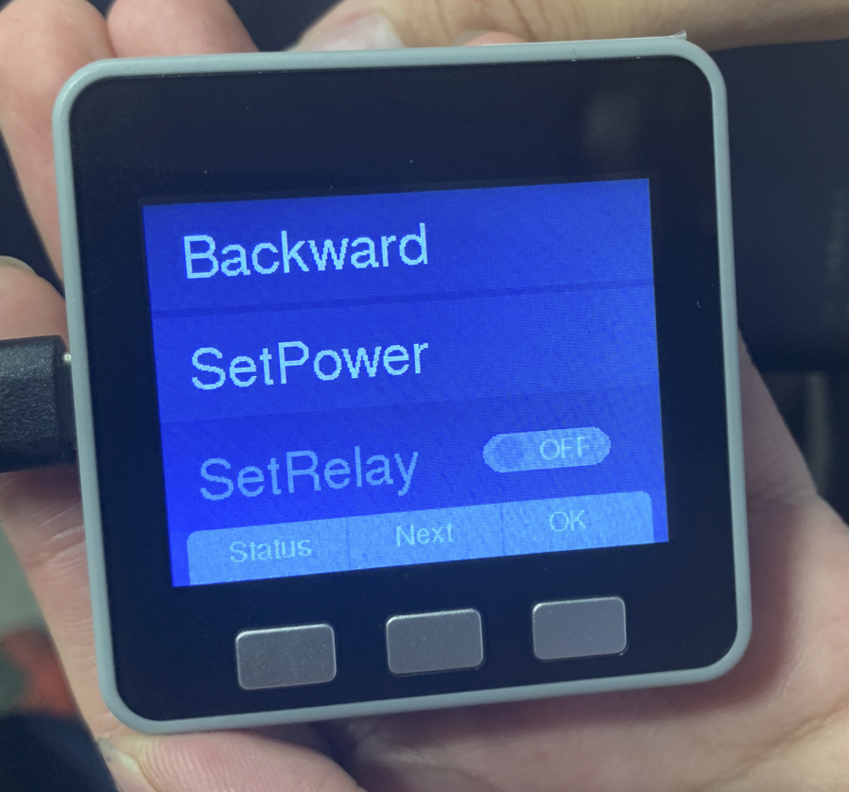
User Interface
UI components
Button panels
Listbox
Radiobox
Button functionalities
Change screen
Next/ Increment variable
OK

Slide 14
Demo
Monitoring Status (Screen 1)
Remotely Control (Screen 2)
Forward + Set Power
Backward
Stop
Set Power
Set Relay
Circuite Protection

Slide 15
Any Questions?

Slide 16
Thank you!

